Slide 1
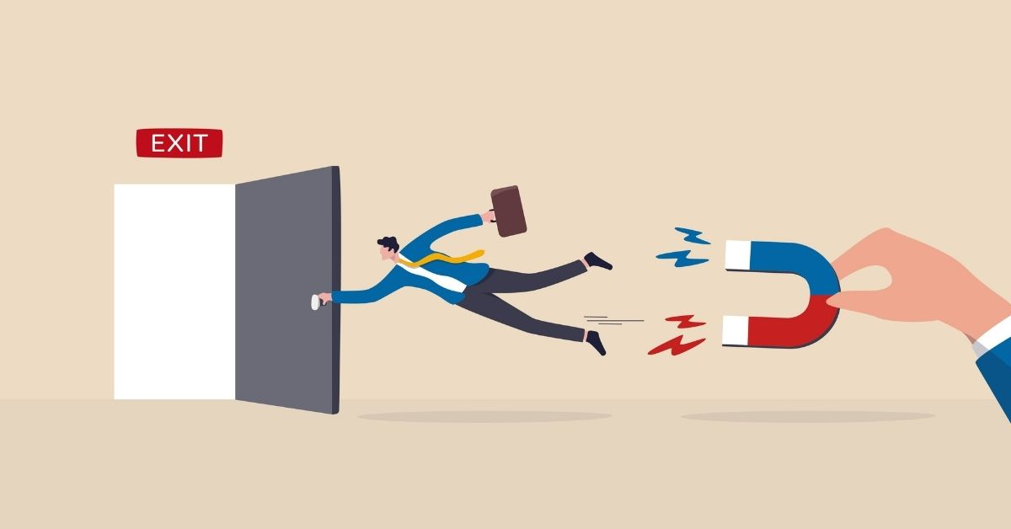


TELECOM CUSTOMER CHURN ANALYSIS
Case Study by: MAYUR V
To view the report, visit: Power BI | Project | Case Study - Telecom Customer Churn Analysis

Slide 2
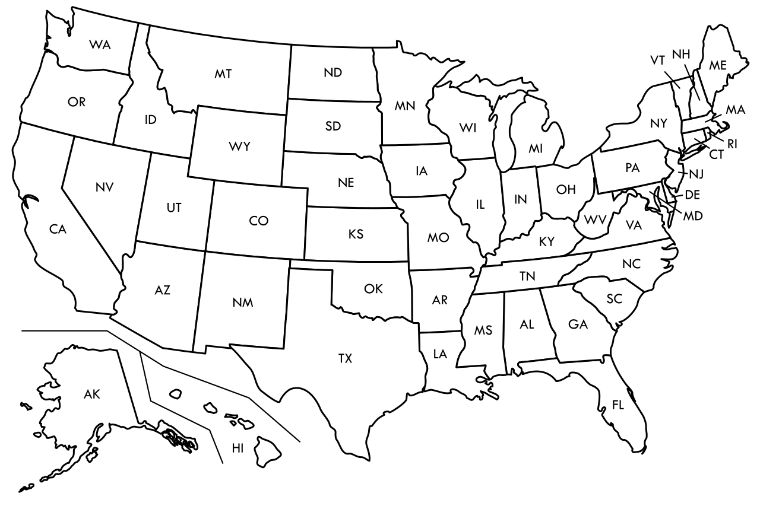
TABLE OF CONTENT
Introduction | An introduction to what churn is and how important it is.
Background | This section is provides the backdrop behind the case study.
Business Problem | The problem faced by the company. The key objectives to be achieved to tackle it.
Key Insights | Insights uncovered over the course of the data analysis.
Recommendations | Suggestions based on insights generated.
Conclusion | Ending remarks.
To view the report, visit: Power BI | Project | Case Study - Telecom Customer Churn Analysis

Slide 3
Sections of report
01
02
03
04
05
06
Introduction
Background
Business Problem
Key Insights
Recommendations
Conclusion
To view the report, visit: Power BI | Project | Case Study - Telecom Customer Churn Analysis

Slide 4
01
Introduction

Slide 5
Introduction
The term “Customer Churn” can be understood as a “Silent Exodus” of customers from a business’s customer base. The churn rate is defined as, the percentage of customers who stopped purchasing a business's products or services during a certain period of time.
The churn rate is one of the two primary factors that need to be balanced in order for a company’s sustainable growth, the other being customer acquisition rate.
Customer acquisition and churn are two sides of the growth coin. While acquisition brings new customers in, churn rate reflects those lost. A healthy balance is crucial: high acquisition alone can't offset churn's drain, while focusing solely on retention limits expansion.

Slide 6
Introduction
Across all businesses in various industries, churn is a big concern as it leads to the loss of loyal subscribers/customers and the erosion of revenue streams. It is especially critical in this industry (telecom) because of:
High Acquisition Costs
Competitive Landscape
Negative Brand Image
Subscription-Based Revenue model
Operational Inefficiency

Slide 7
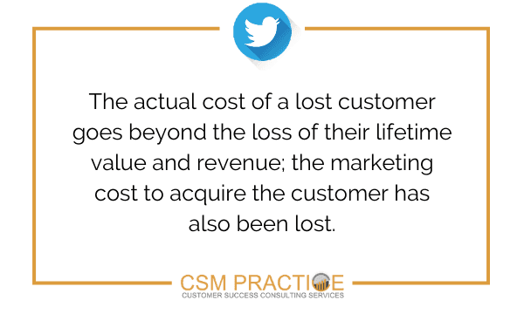
A picture is worth a thousand words

Slide 8
02
Background

Slide 9
Background
This case study delves into Databel, a fictional telecom company grappling with a surge in customer churn. Databel seeks to uncover factors driving the churn, aiming to inform strategic interventions and secure customer loyalty.
In the fiercely competitive telecom industry, the US witnesses an annual churn rate ranging from 21% to 49%, with a recorded rate of 31% in 2021.
Prior to delving into any analysis, it can be beneficial to pinpoint possible causes for the high churn rate.
Service Quality issues
Poor customer service experience
Competitors
Relocation
High Cost

Slide 10
03
Business Problem

Slide 11

Business Problem and Understanding
As observed earlier, Databel is experiencing high churn (~27%) even though it is near previously recorded rates (31% in 2021).
However, much can be done to combat churn and improve the company’s overall revenue and profitability.
The situation prompts a comprehension investigation of every aspect of subscriber behaviour, service usage, satisfaction levels and demographics.
The key objectives of this case study are:
1. Identify Contributing Factors
Via rigorous data analysis
2. Develop Strategic Interventions
Give recommendations based on insights
3. Provide a good report
Use clear visuals and accurate data.

Slide 12
6,687
Total Customers

Slide 13
1,796
26.86%
?
Number of customers who churned
Proportion of customers who no longer use Databel’s products and services
What factors are contributing to this

Slide 14

A picture is worth a thousand words

Slide 15
04
Key Insights

Slide 16


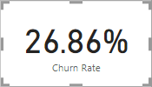
Key Insights
Total Customers
6,687
Churned Customers
1,796
Churn Rate
26.86%

Slide 17
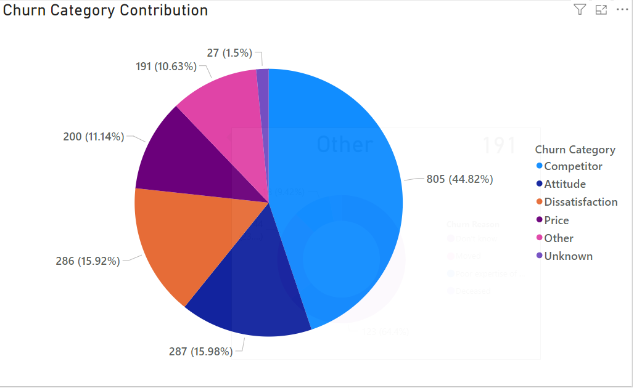
Churn in the company has been divided into multiple categories.
Top 3 contributors:
44.82% - Competitor
15.98% - Attitude
15.92% - Dissatisfaction
Primary cause – Competitors outperforming.
Subsequent contributors: Negative attitude of customer service and customer dissatisfaction.

Slide 18
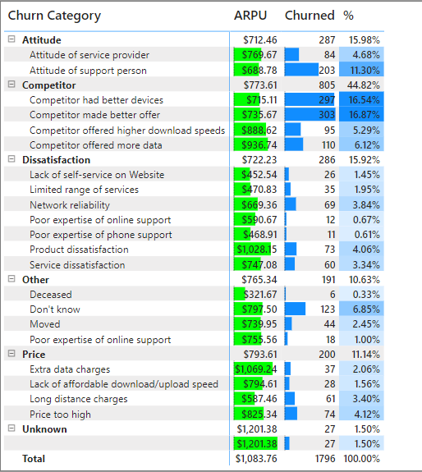
Top reasons for churn:
Competitor made better offer.
Competitor had better devices.
Attitude of support person.
The top reasons indicate fierce competition from competitors.
The attitude of the support person and the service provider (Databel) is leading to significant churn.
This signifies a deficiency in customer support.
These reasons result in a very high loss in revenue.

Slide 19
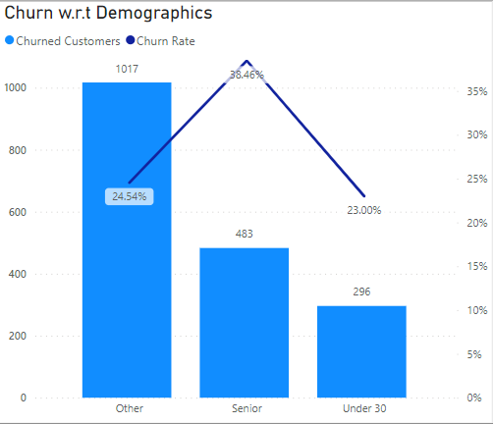
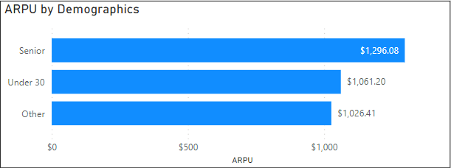
By demographics, Senior customers (above 60) tend to churn at a higher rate when compared to others.
By numbers, Other customers are ~58% of all churned customers.
Senior customers contribute the most revenue, followed by Under 30 customers.

Slide 20
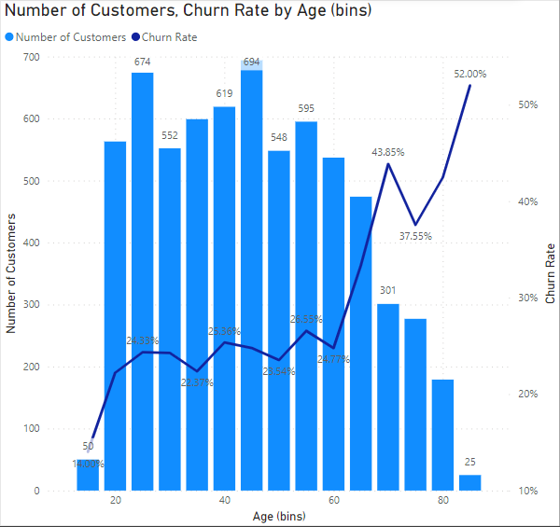
As previously known, customers above 60 (Senior) churn at a higher rate.
However, the bulk of the customers are below the 60 (Other and Under 30).
Their churn rate is around the average churn rate.
Overall, customer churn rate increases with increase in age.

Slide 21
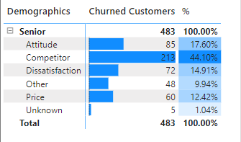
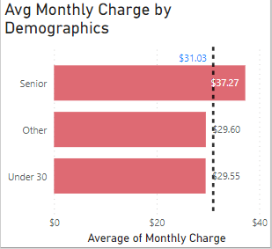
As previously discussed, the major contributors to churn among the Senior demographic still are:
Competitor
Attitude
Dissatifaction
However, price reaons also contribute to churn as it can be seen that Senior customers pay more than other demographics.

Slide 22
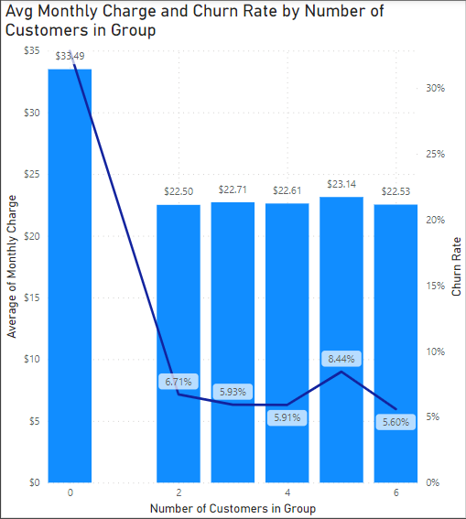
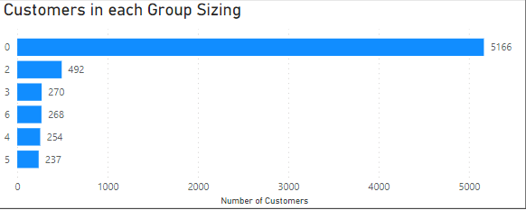
Customers with grouped subscriptions pay significantly less on an average and also are less likely to churn.
Non-group customers churn at a rate of ~33%.
Grouped customers churn at an average rate of 7-8%.

Slide 23
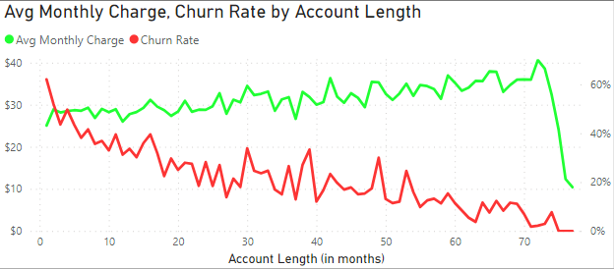
Older customers pay more when compared to new customers, this may indicate further adoption of Databel’s products and services.
Churn rate drops drastically as a customer starts and continues Databel’s products and services for a longer period.

Slide 24
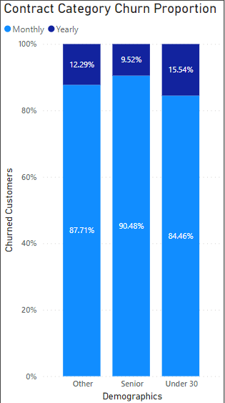
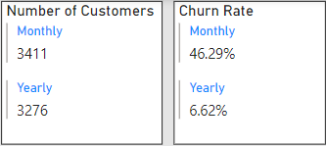
Roughly half of all of customers subscribe to Monthly contracts, while the remaining chooses Yearly contracts.
Monthly contract customer churn at a very high rate of ~46%, while Yearly customers churn at ~7%.
Monthly contract customers contribute similar proportions to churn across all demographics.

Slide 25
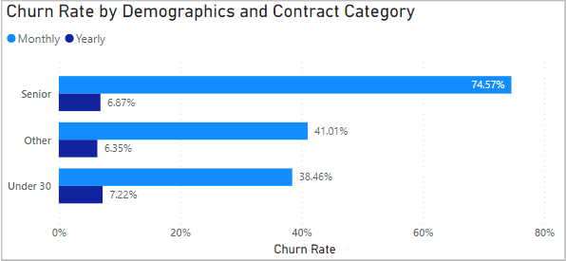
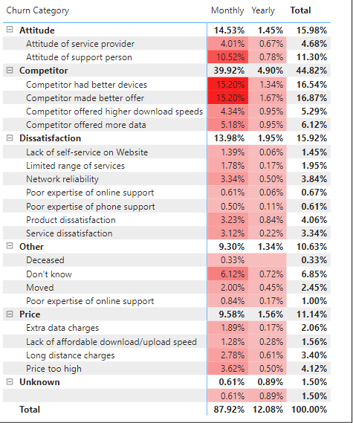
Senior – Monthly customers churn at an unusually high rate of ~75%.
Even across Other and Under 30 – churn is very high for Monthly customers.
Competition is the still major reason for churn by contracts. Attitude is the next significant

Slide 26
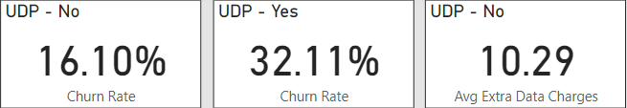
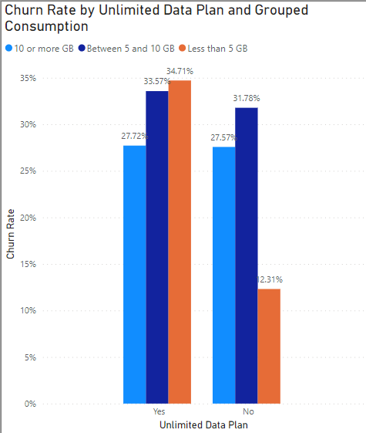
Customers with Unlimited Data Plan tend to churn a lot (32% as opposed to 16%).
Customers without UDP pay an average of ₹10 extra for data.
Customers with UDP consuming less than 5 GB have a very high churn rate when compared to the same without UDP.

Slide 27
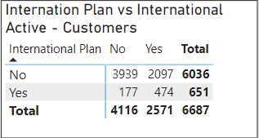
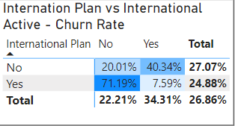
Only 10% of all customer have an international plan.
Around 27% of customers with international plan have churned, while ~25% of those without international plan churned.
Customers with international plan who do not use it churn at a rate of ~71%.
Customers without international plan who are internationally active churn at a rate of ~41%.

Slide 28
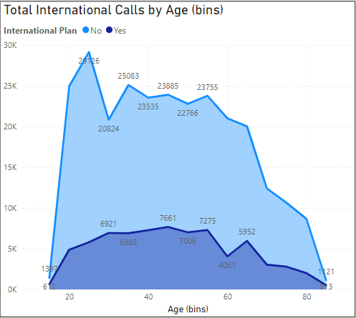
More international calls without a plan are made than with an international plan.
Customers under 30 make a lot of international calls.
Senior customers do not make much international calls.
Customers in the Other demographic also make a lot of international calls.

Slide 29
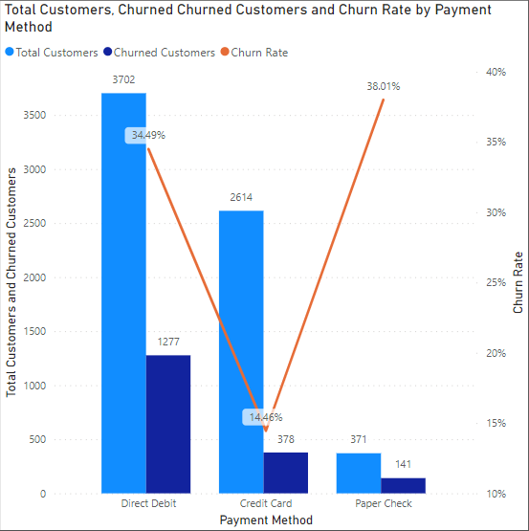
Majority of customers pay using Direct Debit transfer, while a substantial proportion pay using credit card.
Churn is particularly high for customers paying through direct debit and paper check.
Churn is unusually low for customers paying through credit cards.

Slide 30
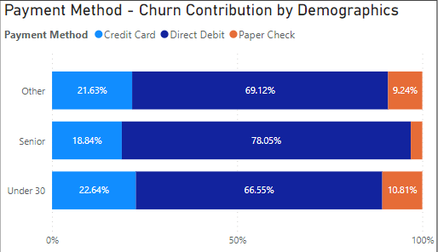
However, direct debit customers churn out the most.
Even across demographics, around 65-80% of churn is of customers who pay via direct debit transfer.

Slide 31
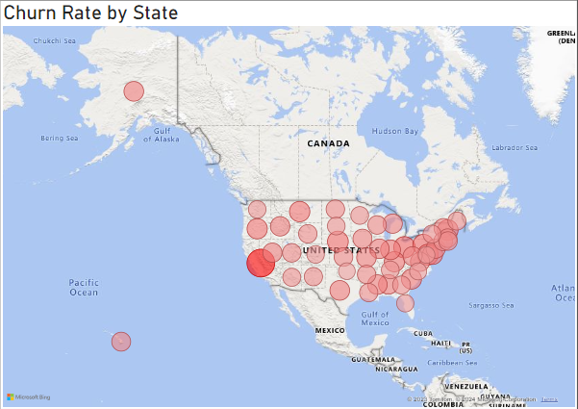
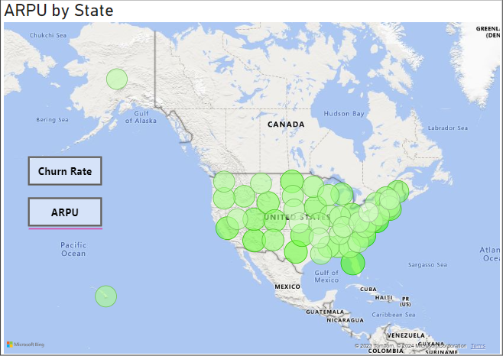
Highest and lowest churn rate are in California and District of Columbia respectively.
Highest and lowest revenue contributors are in California and District of Columbia respectively.
To view the state-wise data as a table, visit: Power BI | Project | Case Study - Telecom Customer Churn Analysis
Right-click on the visual > Show as a table

Slide 32
05
Recommendations

Slide 33
Recommendations
01
05
02
06
03
07
Introduce tailored products and services catering to the unique needs and preferences of the Senior demographic.
Recommend customers with an international plan to refrain from purchasing it further if they are not utilizing its features.
Encourage individual customers to embrace grouped/bundled subscriptions for enhanced value and convenience.
Introduce new plan options to incentivize non-plan customers who frequently make international calls, encouraging them to switch to international plans for better value..
Enhance the value proposition for Monthly plan/contract customers by providing more enticing and rewarding offers.
Concentrate on enhancing products and services to effectively address competition and elevate overall customer satisfaction and loyalty.
04
Recommend customers with Unlimited Data Plan who consistently use less than 5GB per month to consider downgrading their plans to better align with their usage.
In a broader context, focus efforts towards enhancing the overall product, service and customer experience to effectively tackle churn and earn customer loyalty.
08

Slide 34
06
Conclusion

Slide 35
Conclusion
The telecom industry experiences churn in the range of 21-49%, with a record rate of 31% in 2021.
In the competitive industry of telecom, tackling churn is very important for a telecom provider to survive in business.
In the course of the analysis, it became apparent that customers exhibiting specific demographics, contract preferences, and plan selections were particularly susceptible to churning within Databel's customer base.
However, implementation of the provided recommendations (based on robust analysis) has the potential to effectively mitigate customer churn for the Databel.

Slide 36
Thanks for your patience!
To view the full report, visit: Power BI | Project | Case Study - Telecom Customer Churn Analysis
The report users can explore data further!
Suggestions and feedback are welcome!
I would respond to feedback and refine the report based on it.

Slide 37
Thanks!
Ignore this page ☺
CREDITS: This presentation template was created by Slidesgo, and includes icons by Flaticon, and infographics & images by Freepik
Please keep this slide for attribution

